Slide 1
PP Model
Pipeline Parallelism (PP) for Inference

Slide 2

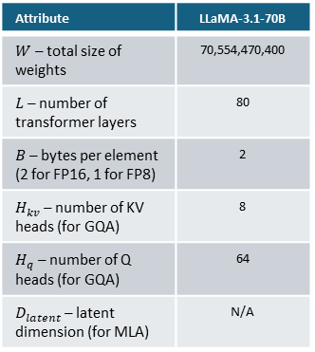



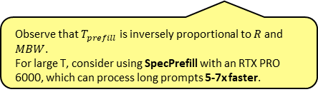



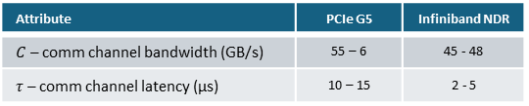
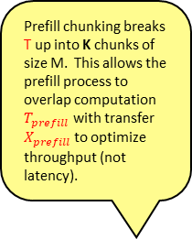

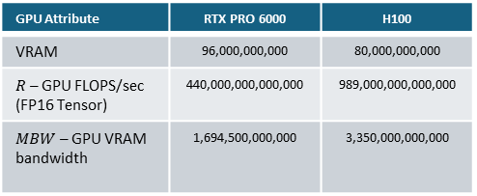
PP Pipeline (Logical View)
Prefill
Decode
Attribute | PCIe G5 | Infiniband NDR
$C$ – comm channel bandwidth (GB/s) | 55 – 6 | 45 - 48
$τ$ – comm channel latency (µs) | 10 – 15 | 2 - 5
Attribute | LLaMA-3.1-70B
$W$ – total size of weights | 70,554,470,400
$L$ – number of transformer layers | 80
$B$ – bytes per element (2 for FP16, 1 for FP8) | 2
$H_{kv}$ – number of KV heads (for GQA) | 8
$H_{q}$ – number of Q heads (for GQA) | 64
$D_{latent}$ – latent dimension (for MLA) | N/A
Different model attention types entail different KV-cache sizes:
$$KV=\left\{\begin{matrix}{KV}_{GQA}=2×N×B×T×H_{model}×\frac{H_{kv}}{H_{q}}×L & for GQA models \\ {KV}_{MHA}=2×N×B×T×H_{model}×L & for MHA models \\ {KV}_{MLA}=N×T×L×H_{kv}×D_{letent}×2×B & for MLA models\end{matrix}\right.$$
Prefill chunking breaks T up into K chunks of size M. This allows the prefill process to overlap computation $T_{prefill}$ with transfer $X_{prefill}$ to optimize throughput (not latency).
GPU Attribute | RTX PRO 6000 | H100
VRAM | 96,000,000,000 | 80,000,000,000
$R$ – GPU FLOPS/sec (FP16 Tensor) | 440,000,000,000,000 | 989,000,000,000,000
$MBW$ – GPU VRAM bandwidth | 1,694,500,000,000 | 3,350,000,000,000
Activations volume (T=1)
$$A_{decode}=N×B×H_{model}$$
Activations volume
KV-cache volume
D
D
D
D
Naïve latency (no contention):
$$A_{prefill}=N×B×T×H_{model}$$
P
P
P
P
$${KV}_{handoff}=\frac{{KV}_{GQA}×L_{rank}}{L}$$
Naïve latency (no contention):
$$X_{decode}=\frac{A_{decode}}{C_{rank}}+τ_{rank}$$
$$X_{prefill}=\frac{A_{prefill}}{C_{rank}}+τ_{rank}$$
$$T_{decode}=max⁡\left(\frac{2×W_{rank}×N}{R_{rank}},\frac{W_{rank}×B+{KV}_{rank}}{{0.75×MBW}_{rank}}\right)$$
K
K
K
K
$$T_{prefill}=max\left(\frac{\left(2×N×T×W_{rank}\right)+\left(2×N×L_{rank}×H_{model}×T^{2}\right)}{R_{rank}},\frac{B×W_{rank}+{KV}_{rank}}{0.75×{MBW}_{rank}}\right)$$
V
V
V
V
Naïve latency (no contention):
Compute time
Memory wall
$$X_{handoff}=\frac{{KV}_{handoff}}{C_{rank}}+τ_{rank}$$
Observe that $T_{prefill}$ is inversely proportional to $R$ and $MBW$.
For large T, consider using SpecPrefill with an RTX PRO 6000, which can process long prompts 5-7x faster.
N
GQA Model Data Sizes
$${KV}_{handoff}>A_{prefill}≫A_{decode}$$
T
$${KV}_{handoff}=2×N×B×T×H_{model}×\frac{L_{rank}}{8}$$
$$A_{prefill}=N×B×T×H_{model}$$
$$A_{decode}=N×B×H_{model}$$

Slide 3
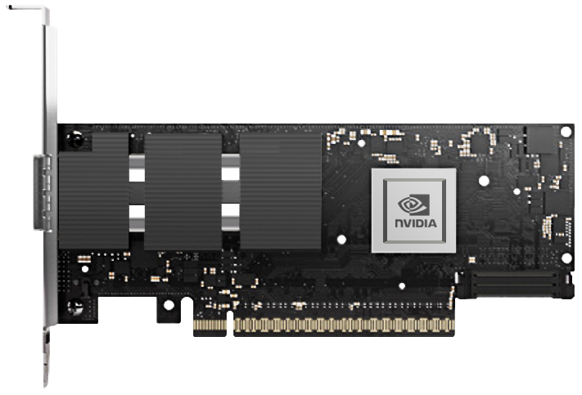
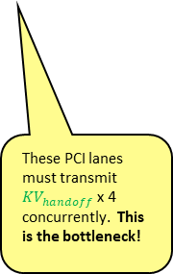

PP Pipeline (Physical View)
Decode
Decode
Decode
Decode
Switch
Server
Infiniband NDR
Switch
Server
Prefill
RTX PRO
6000
Server
Infiniband NDR
RTX PRO
6000
Infiniband NDR
PEX
Infiniband NDR
Ethernet
RTX PRO
6000
These GPUs need to concurrently transmit $A_{prefill}$ and ${KV}_{handoff}$via their PCI interface.
Server
Infiniband NDR
These PCI lanes must transmit ${KV}_{handoff}$ x 4 concurrently. This is the bottleneck!
RTX PRO
6000
Server
Infiniband NDR

Slide 4

PP Pipeline (Physical View)
Decode
Decode
Decode
Decode
Switch
Server
Infiniband NDR
Switch
Server
Prefill
Infiniband NDR
RTX PRO
6000
Server
Infiniband NDR
Infiniband NDR
RTX PRO
6000
PEX
Infiniband NDR
Ethernet
These GPUs need to concurrently transmit $A_{prefill}$ and ${KV}_{handoff}$via their PCI lanes. This is the bottleneck!
RTX PRO
6000
Infiniband NDR
Server
Infiniband NDR
RTX PRO
6000
Infiniband NDR
Server
Infiniband NDR

Slide 5

PP Pipeline (Physical View)
Decode
Decode
Decode
Decode
Switch
Server
Infiniband NDR
Switch
Server
Prefill
Infiniband NDR
H100
NVLink Bridge
Server
Infiniband NDR
Infiniband NDR
H100
Infiniband NDR
Ethernet
NVLink Bridge
By using NVLink bridges between H110s, $A_{prefill}$ can be transferred over NVLink, and ${KV}_{handoff}$can be transferred over PCI lanes.
This is the perfect topology!
H100
Infiniband NDR
Server
Infiniband NDR
NVLink Bridge
H100
Infiniband NDR
Server
Infiniband NDR

